Slide 1
HOW DO I CITE MY SOURCES?

Slide 2
What is a citation?
The citation summarizes bibliographic information to allow your reader/teacher to find the source that you used:
Author (if given)
Title of article, webpage, or entry
Publication information (publisher, website, magazine title, date, location)
Medium (print, web, etc.)
Date of access

Slide 3
What does a citation look like?
The parts of the citation follow a specific order and have their own function. Citations follows a specific format. Punctuation used in the citation defines different types of information in the entry. Formatting is very important.
You can use easybib.com to format it for you.
HOWEVER, you need to be able to check the citation to see if it looks right and adjust it if your teacher/professor ever asks for something different.

Slide 4
Step-by-step: Easy Bib
Type in the ISBN (book) or the URL (website) in the box and click “Cite It”, then click “Continue”
Double-check the information it plugged in, and fill in any missed information, then click “Create Citation”
Use proper capitalization
If you can’t find it, leave it blank
Do not include the URL unless you think your source is hard to find without it or if your teacher/professor has asked you to include it
Copy the citation and paste it in your Works Cited page – double-check that formatting (like italics) copied correctly

Slide 5
Step-by-step: Easy Bib
If your book or website isn’t found in their database, click “Manual cite” and select the source type
Fill in the information you can, then click “Create Citation”
Use proper capitalization
If you can’t find it, leave it blank
Do not include the URL unless you think your source is hard to find without it or if your teacher/professor has asked you to include it
Copy the citation and paste it in your Works Cited page – double-check that formatting (like italics) copied correctly

Slide 6
Let’s try it!
I will demonstrate creating a citation using Easy Bib for the “teachers” article on the Occupational Outlook Handbook.
http://www.bls.gov/ooh/education-training-and-library/high-school-teachers.htm
When I get the citation, I copy and paste it to my Works Cited page (more details on that next!):
This sample citation includes the URL so you can see it, but you should only include the URL if your source would be hard to locate without it.
"High School Teachers." Bureau of Labor Statistics. N.p., 05 Apr
2012. Web. 5 Nov 2013. <http://www.bls.gov/ooh/education-
training-and-library/high-school-teachers.htm>.

Slide 7
What’s a Works Cited page?
The Works Cited page is listing of citations for all the sources used for your research. This list could include books, websites, databases, interviews, and any other source of information used.
Remember that if you use someone else’s ideas, words, quotes, data, or other information, you must cite your source.

Slide 8
How do I format a Works Cited page in MLA format?
The Works Cited page is a new page at the end of your essay (use a page break – ctrl + enter)
The page is in the same font, size and spacing as the rest of your essay
The page has the same header as the rest of your essay
The page is titled “Works Cited”, which is centered at the top of the page (but NOT bold or anything else)
The page has a ½ inch hanging indent.
On Google docs and Microsoft Word, click the lower half of the far left triangle on the ruler and slide it to the right a half an inch
If you use a long URL, you may get weird line breaks. If this happens, you can insert a space in a natural break in the URL to make it go to the next line

Slide 9
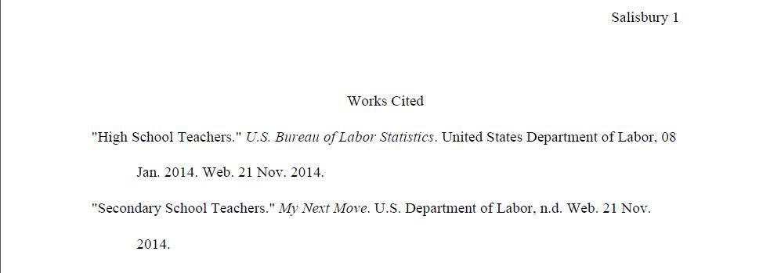
What should it look like in MLA format?
Works Cited centered at top
Entries are alphabetized
Page has ½” hanging indent

Slide 10
In review…
A citation is a summary of bibliographic information for your reader.
A Works Cited page is an alphabetical listing of your properly-formatted citations.

