Slide 1
Greek and Latin Root Words
ject

Slide 2
Ject
Means “to throw”

Slide 3
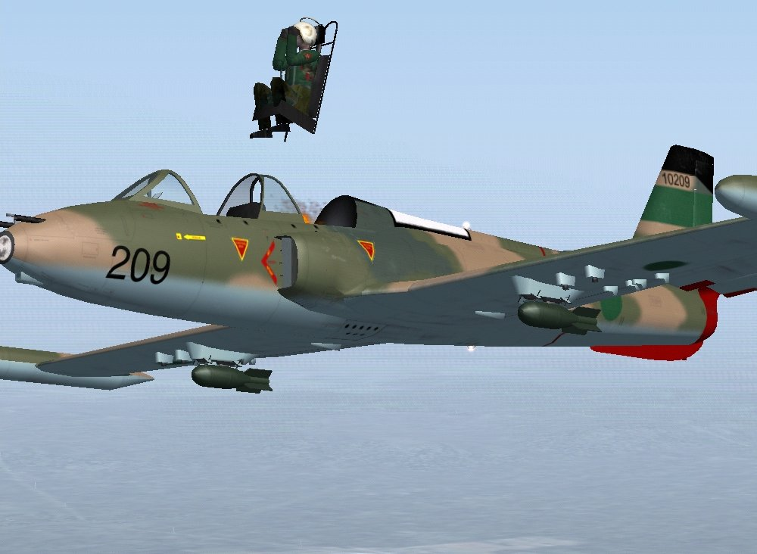
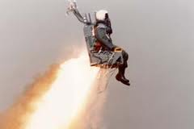
eject
To throw out

Slide 4
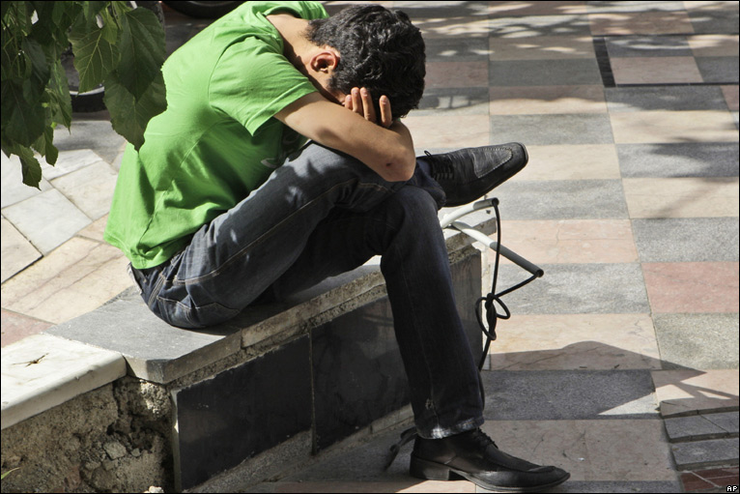
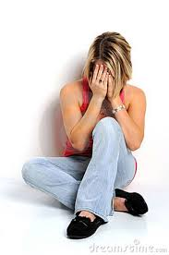
Dejected
to feel sad; to feel thrown down in spirit

Slide 5
Injection
a shot,
to throw medication into the body

Slide 6
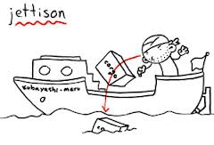
Jettison
To throw goods overboard to lighten the load on a boat or an airplane

Slide 7
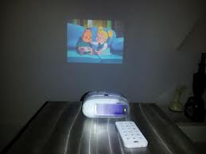
projector
A machine that throws an image on a wall

Slide 8
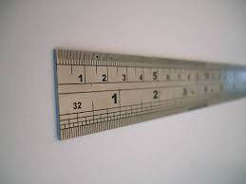
Subject
To throw oneself under someone else’s rule or authority

Slide 9
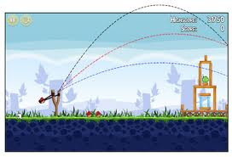
Trajectory
The curved path of an object
thrown into space

Slide 10
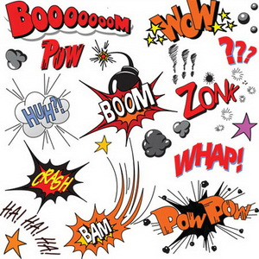
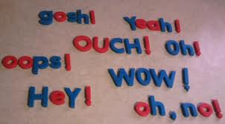
Interjection
A word thrown into a sentence or conversation

Slide 11
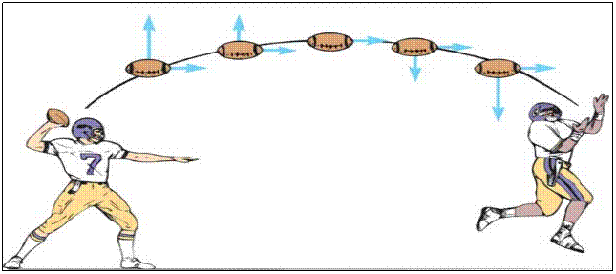
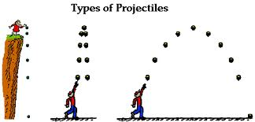
Projectile
An object thrown into the air with great force

Slide 12
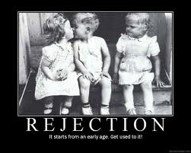
Reject
To throw something out or not accept it

