Slide 1
Vocabulary: miss, mit
send

Slide 2
admit
To send someone in;
to allow someone to enter

Slide 3
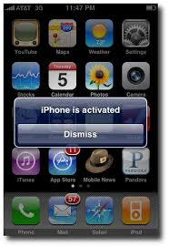
dismiss
To send someone out;
to let someone leave

Slide 4
emit
To send out or give off
(such as an odor)

Slide 5
intermission
A break between acts of a play or performance

Slide 6
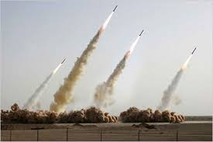
missile
A weapon designed to be sent
in the direction of a target

Slide 7
mission
A special duty or function which
a person or group is sent out to do

Slide 8
omit
To leave out; to not send

Slide 9
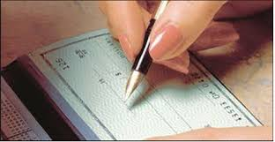
remit
To send back
(usually related to paying bills)

Slide 10
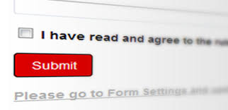
submit
To give in to someone else’s power

Slide 11
transmit
To send something across places

